Slide 1

Suicide:
From Durkheim to today
Jason ficorilli

Slide 2

Problem background
Inspiration for project: Emile Durkheim’s Suicide (1897)
Foundational work in field of sociology
Sought to find the social reasons behind differing suicide rates
Some of Durkheim’s findings:
Suicide rates are higher among Protestants than Catholics
Suicide rates are higher in men than in women
Suicide rates are higher in Scandinavian countries
Project goal:
Use a dataset of suicide rates in the 21st century to test if Durkheim’s findings still hold up

Slide 3
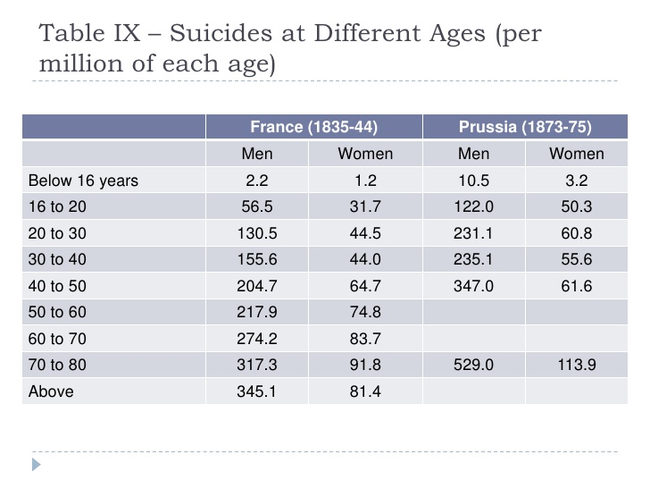
Durkheim’s findings

Slide 4
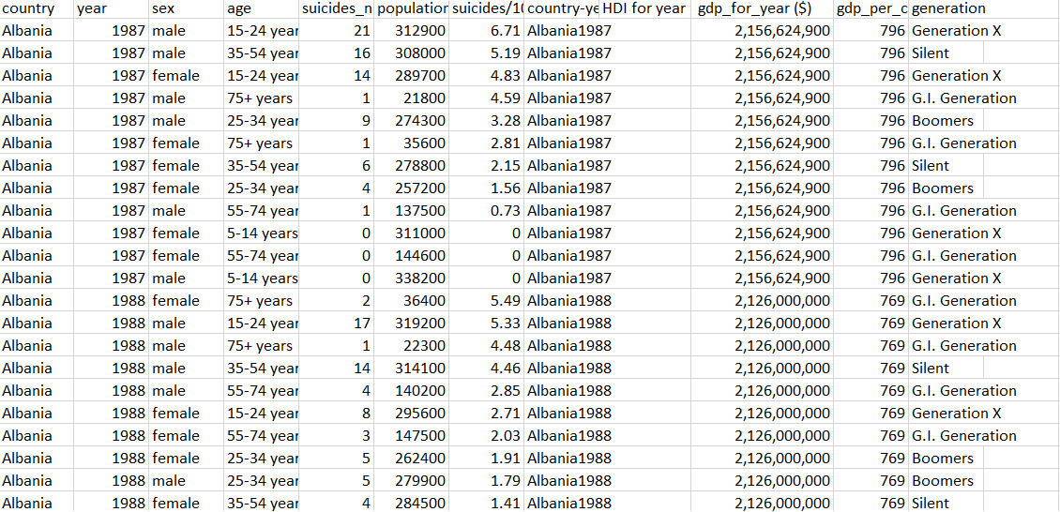
The dataset
Source: “Suicide Rates Overview 1985 to 2016” from Kaggle
Data comes from the United Nations, World Bank, and World Health Organization
Columns:
Country
Year
Sex
Age Range
Number of Suicides
Population
Suicides Per 100K People
HDI
GDP
GDP Per Capita
Generation

Slide 5
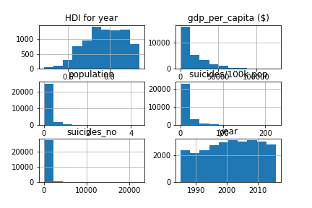
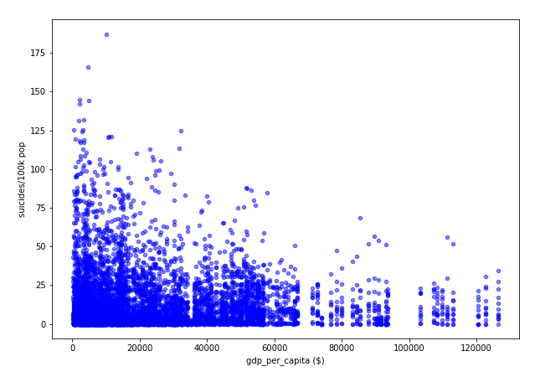
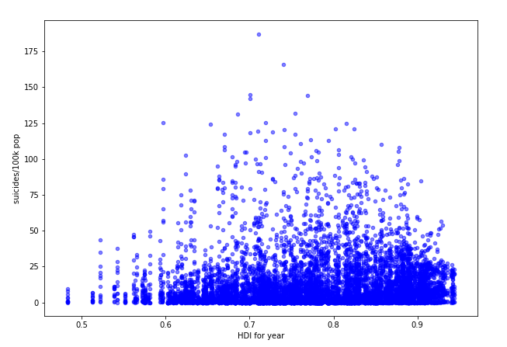
Analysis methods
Found number of null cells
Plotted histogram for each numeric column to find overall distribution
Made scatterplots mapping suicides per 100k people vs. GDP and HDI

Slide 6
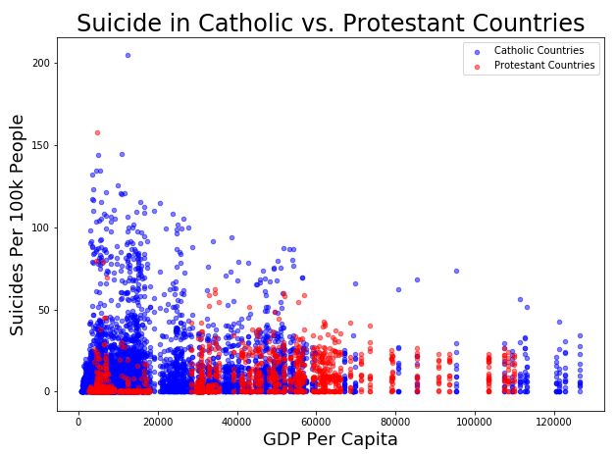
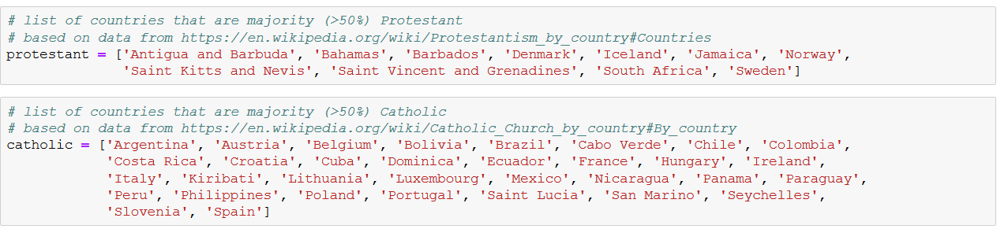
Analysis methods
Grouped by sex to compare suicide rates between men and women
Made separate dataframes for majority-Catholic and majority-Protestant countries (if they were over 50% of either religion according to Wikipedia) and filtered for data after 1999
Filled in null data for HDI
Made scatterplot to compare overall distribution of Catholic vs. Protestant data
Aggregated data for each country so it was no longer separated by gender or by age range

Slide 7
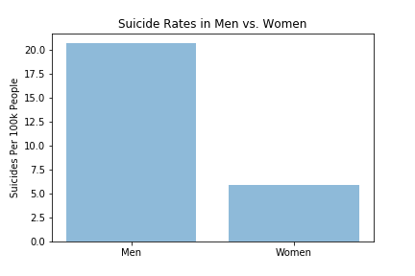
findings
Found that men commit suicide at a rate nearly 4 times higher than women (confirming Durkheim’s findings)

Slide 8
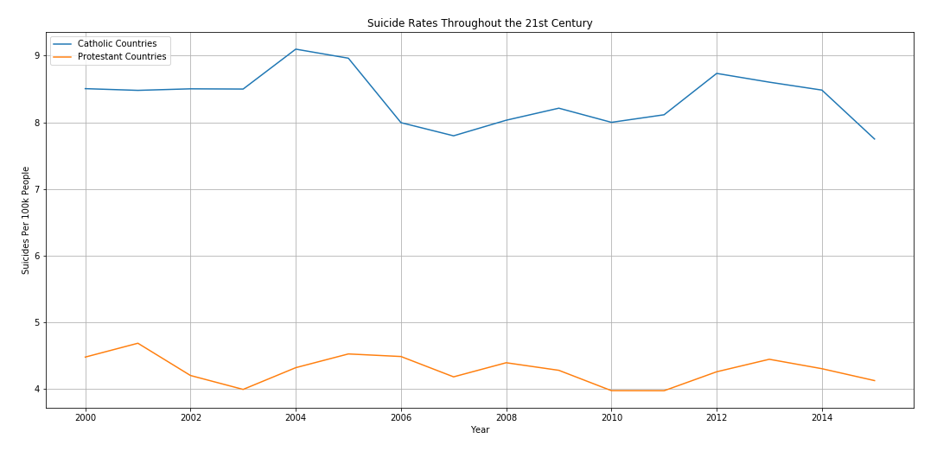
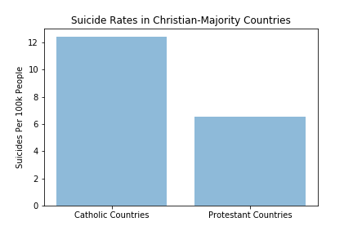
findings
Catholic-majority countries have a suicide rate nearly 2 times higher than Protestant-majority countries (opposite of Durkheim’s findings)
Scandinavian countries (grouped in with Protestant-majority countries) do NOT have higher suicide rates (opposite of Durkheim’s findings)

Slide 9
Limitations & possibilities
Data excluded nearly all of Africa and Asia
Could’ve been more data present for Protestant-majority countries
Data was not available for all countries for the entire range of 1985-2016
HDI score was not present in many rows of data, had to either be calculated based on the country’s average HDI or rows had to be dropped
Former Soviet countries didn’t have data from before the collapse of the USSR
Could be interesting to compare suicide rates before and after the collapse
Possibility: how does overall wealth inequality of a country factor in to suicide rates?

